Slide 1
Predicting Heart Disease Outcomes in Patients
Gokul Kannan
05 / 13 / 2025
All data was taken from Kaggle

Slide 2
Contents
05 / 13 / 2025
1.
Discuss the Problem
2.
Review over the Data set
3.
Challenges Faced
4.
Algorithms Used and Justification
5.
Final Evaluation
6.
Closing Thoughts

Slide 3
Project Overview
1
2
3
4
05 / 13 / 2025
The Problem
Machine Learning
Outlook
Real World Application
UI for Software
In this data I analyze CVD, a general term for any cardiovascular disorder.
Each year, thousands of people are killed due to CVD, with millions being debilitated by CVD.
I was hoping to Machine learning (Logistic Regression in particular) to account for various factors and variables that contribute to CVD and see what placed patients at high risk.
After utilizing the results of my logistic regression and PCA, I hoped to rank the top contributing factors and created an educational software to introduce patients to practices that can reduce their risk.
If I had more time on this project I would have expanded this part of the project to be a mobile or web application for ease of use.

Slide 4
Dataset Review
Source: Kaggle
Data Source Contributors:
Hungarian Institute of Cardiology. Budapest: Andras Janosi, M.D.
University Hospital, Zurich, Switzerland: William Steinbrunn, M.D.
University Hospital, Basel, Switzerland: Matthias Pfisterer, M.D.
V.A. Medical Center, Long Beach and Cleveland Clinic Foundation: Robert Detrano, M.D., PhD.
My dataset has 14 features with over 300 observations (or patients recorded)
Concerns
I was worried I did not have enough features to apply logistic regression on, and that these features may not exhibit a strong connection or correlation with CVD outcomes
I also was worried that my data might not have enough observations to display enough information and influence my algorithms with noise
My data also only captures the cardiovascular history of select patients and may not be inclusive to other patients with varying medical history etc.
Preprocessing on my Data
I ran my previous logistic regression models on this data
Applied normalization and standardization on my data to scale varying metrics
If I were to include data from other health sources I would have to retain information so data is consistent and remove and NaN values present

Slide 5
Major Challenges
05 / 13 / 2025
Small Dataset
If given more time I would have gathered data from more sources and congregated them into one data set. The issue is this can be very time consuming because how varied different health data is, and I wasn't sure how to deal with potential NaN data.
Numerically Ranking and Measuring the Impact of each Metric
Ranking each feature in my data by a certain numerical value to later judge whether patients were in a ‘healthy’ range was extremely difficult

Slide 6
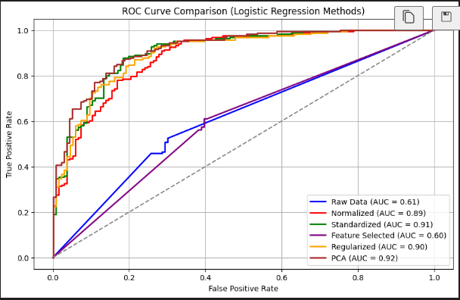
Algorithms Utilized
I first applied logistic regression directly on the raw data, but that basically never performs well because of how the data is scaled.
I saw similar performance on all of the other algorithms with the exception of feature selection (likely because it was applied directly on the raw data and not a preprocessed form of it)
Even though PCA usually performed the best in the AUC curve, the way each principal component is designed is to capture as much variance in the input data as possible. So when I needed measure the impact of each feature on the target variable, PCA did not work.
So for my educational software application I utilized the weights I got from my normalized logistic regression model.

Slide 7
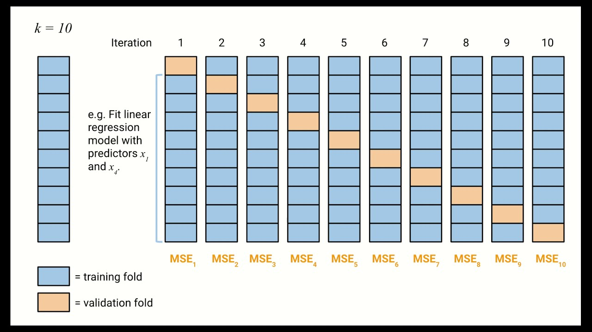
10-Fold Cross Validation for Each Model
Even though I ended up choosing the logistic regression model on normalized data, I trained all of my models and tested them using 10-fold cross validation.
Separated data into 10 chunks
Utilized each chunk as testing data with the other nine as training data to optimize each regression model and utilize gradient descent to minimize cost function
I stored each model in a list, and I iterated through all of them. For each model I iterated through every fold so I could apply the 10 fold cross validation equally for each model so they were trained under the same conditions. This way no model’s performance could be momentarily enhanced or harmed relative to other models based on a lucky distribution of testing & training data.

Slide 8
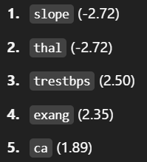
Evaluation
I found that these features on the right were the most impactful for the model (logistic regression with normalization for preprocessing) to determine whether or not a patient would develop CVD.
Slope - The rate at which a person’s heart can change its rate (think about it like the acceleration of the heart)
Thal - Stands for Thalassemia and are a group of genetic blood disorders that impact the efficiency of hemoglobin
Trestbps - A person’s resting heart rate
Exang - Stands for exercise-induced angina, or the tendency for a person to experience chest pains during exercise
Ca - refers to the Calcium levels in a patient’s bloodstream and measures how potentially clogged a person’s blood vessels are (this is also correlated with blood pressure and the efficiency of blood circulation)

Slide 9
Evaluation (Continued)
I think overall the project and UI perform pretty well given the dataset.
However there definitely are weaknesses in the performance and evaluation of the dataset
For example, It is heavily reliant on the range, mean, and standard deviation of the dataset to determine what is a ‘healthy’ range for various values and essentially due to certain limitations on the size of the dataset and the specific people (and consequently their genetic makeup) who are included in the dataset
Additionally, the UI is still very basic right now and offers general health advice, and it can be complicated for user’s to determine their values for the features above to input

Slide 10
Any questions?
Ask away!
05 / 13 / 2025
Let's discuss any doubts or concerns.

Slide 11
Thank you!

